Slide 1

Quality Gates with Keptn
Automation, Self-Service and Delivery Choreography with keptn

Slide 2
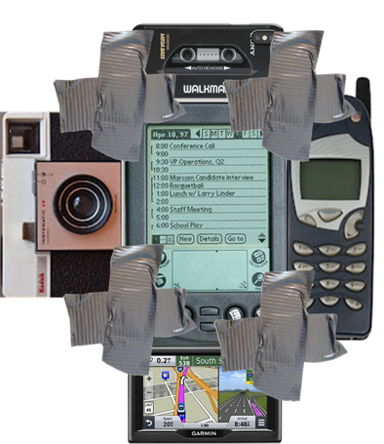
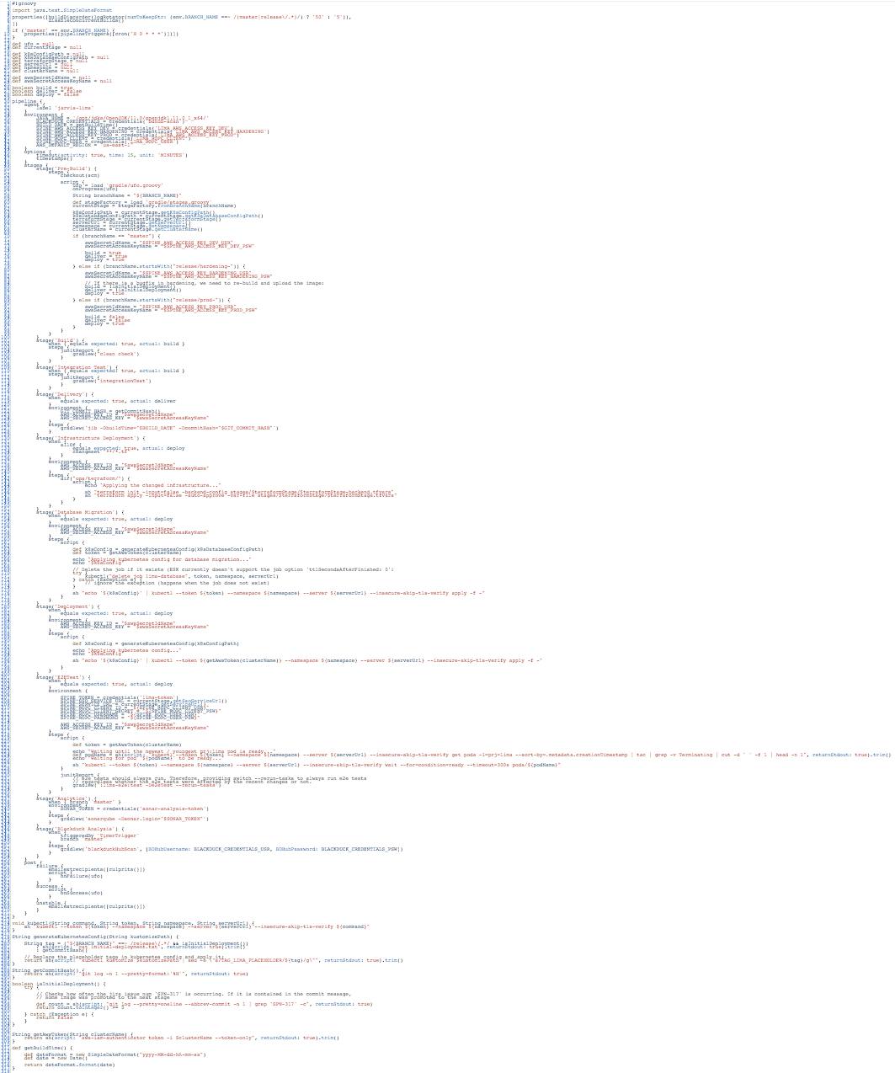












Pipelines for Continuous Delivery are becoming complex
“Pipelines seem to be becoming our new future unmanagable legacy code.“
Jenkins Pipeline for CD
Notes:
Let’s first start by establishing the context. What are the problems that we are trying to solve?
This came from surveys and discussions we had with customers. We also did some introspection within our own development teams.
This to realize that continuous delivery pipelines are becoming unmanageable over time.
So you start building a delivery pipeline and after a while it becomes more and more customized ad it requires an increasing effort to integrate with tooling.
But also there’s no separation of concerns, the pipelines, they’re like monoliths
There’s a mix of information and dependencies about the process, the platform they target, the environments (dev, staging, etc), and the tools they integrate with.

Slide 3
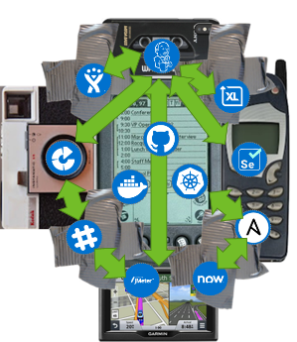

The complexity problem spreads across the organization
1 Service = 1 Pipeline
1 Team = x Pipelines
n Teams = n*x Pipelines
pipeline {
stages {
stage('Deploy to dev namespace') {
steps {
container(‘helm’) {
}
}
}
stage('Run tests') {
steps {
container(‘hey’) {
}
}
}
stage(‘Evaluate performance’) {
steps {
container(‘curl’) {
}
}
}
if (evaluation.passed) {
stage('Deploy to staging') {
steps {
container(‘helm’) {
}
}
}
}
}
}
pipeline {
stages {
stage('Deploy to dev namespace') {
steps {
container(‘helm’) {
}
}
}
stage('Run tests') {
steps {
container(‘jmeter’) {
}
}
}
stage(‘Evaluate performance’) {
steps {
container(‘curl’) {
}
}
}
if (evaluation.passed) {
stage('Deploy to staging') {
steps {
container(‘helm’) {
}
}
}
}
}
}
pipeline {
stages {
stage('Deploy to dev namespace') {
steps {
container(‘kustomize’) {
}
}
}
stage('Run tests') {
steps {
container(‘jmeter’) {
}
}
}
stage(‘Evaluate performance’) {
steps {
container(‘curl’) {
}
}
}
if (evaluation.passed) {
stage('Deploy to staging') {
steps {
container(‘helm’) {
}
}
}
}
}
}
pipeline {
stages {
stage('Deploy to dev namespace') {
steps {
container(‘helm’) {
}
}
}
stage('Run tests') {
steps {
container(‘jmeter’) {
}
}
}
stage(‘Evaluate performance’) {
steps {
container(‘curl’) {
}
}
}
if (evaluation.passed) {
stage('Deploy to staging') {
steps {
container(‘helm’) {
}
}
}
}
}
}
pipeline {
stages {
stage('Deploy to dev namespace') {
steps {
container(‘helm’) {
}
}
}
stage('Run tests') {
steps {
container(‘selenium’) {
}
}
}
if (evaluation.passed) {
stage('Deploy to staging') {
steps {
container(‘helm’) {
}
}
}
}
}
}
“Pipelines seem to be becoming our new future unmanagable legacy code.“
Notes:
As continuous delivery expands within your organization and,
at the same time,
as you evolve towards microservices architectures,
there’s a multiplication in the number of pipelines, in typical devops approach, used by different teams,
and each customized their own way,
which make those pipelines even harder to manage and maintain.

Slide 4
Remember the goal : deliver better quality builds faster
“We spend more time in manual communication than remediating issues.“
NUMBER OF ISSUES
PROBLEM: mostly manual
MANUAL COMM
MANUAL COMMUNICATION
Before
ENGAGE
TRIAGE
FIND & ASSEMBLE
RESOLVE
RESTORE
SOLUTION: automate
RESOLVE
RESTORE
After
Notes:
So not only the delivery pipelines are multiplying and getting more difficult to manage, the thing is they spend most of their time sitting and waiting for approval which involved a lot of manual work and is error prone
Wasted time and undetected defects are what is killing a delivery pipeline.
So the solution is to automate that part and we reduce the time to delivery while also, if we do well, reduce the chances of delivering a bad bad release.

Slide 5












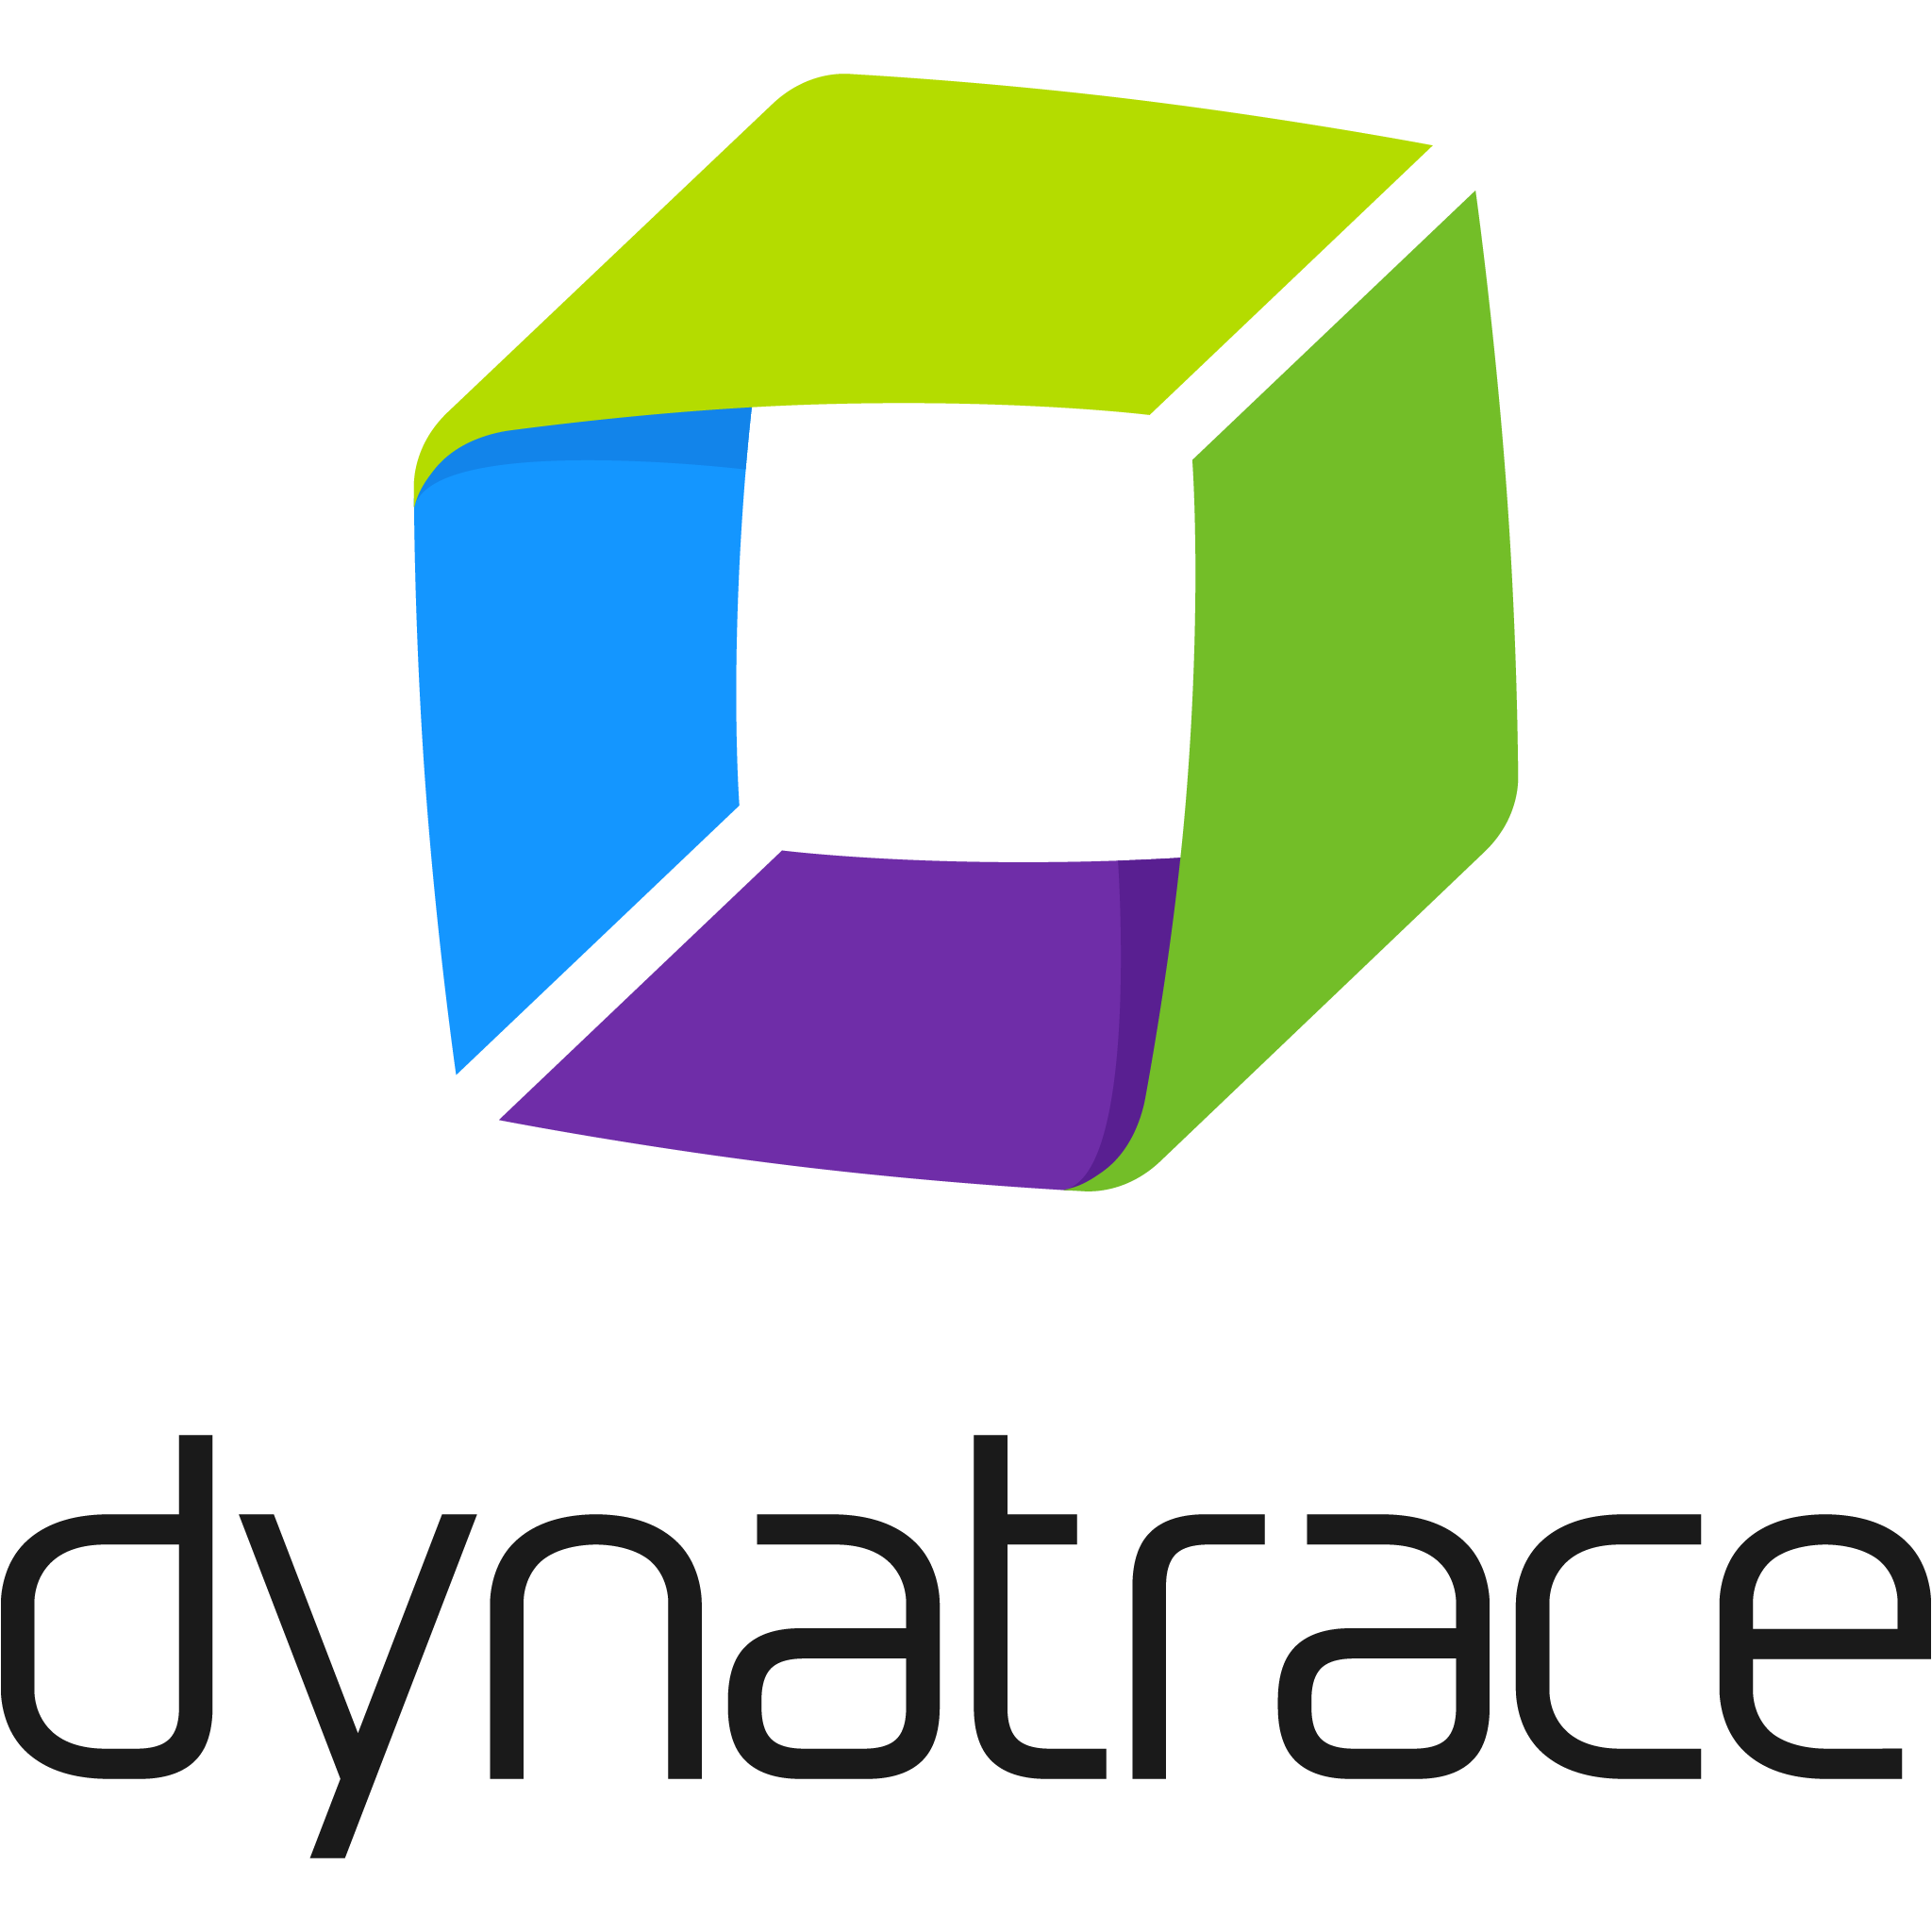


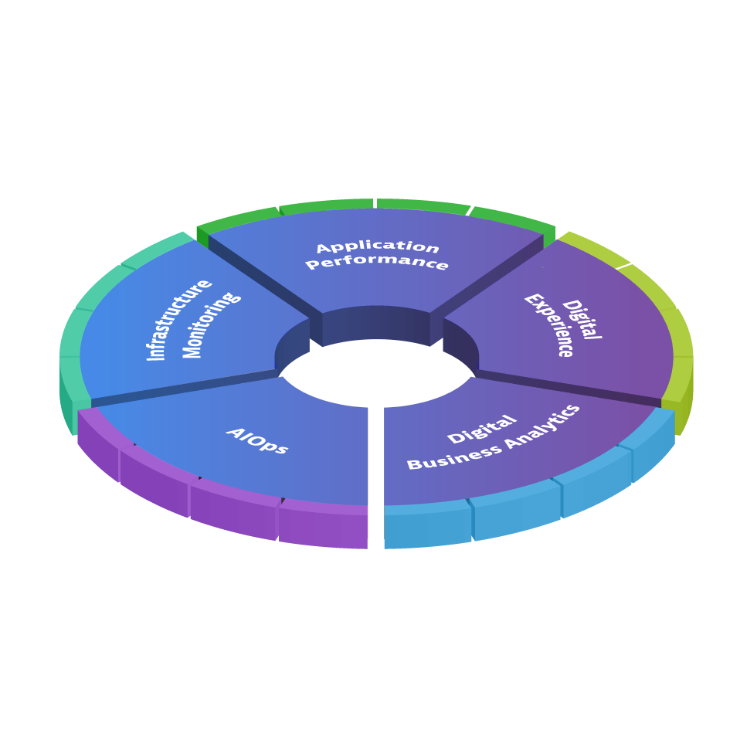

Keptn for Autonomous Cloud Enablement
Performance as
a Self-Service
Deployment Validation
Progressive Delivery
Auto-Remediation
api.keptn.*
Event-Driven Control Plane for Autonomous Cloud
bridge.keptn.*
keptn install

Slide 6
Building Blocks for Autonomous Cloud
Becoming Cloud Native
Increase Quality &
Level of Automation
AUTOMATE
OPERATIONS
Auto
Roll-Back
Adaptive
Scaling
Auto-Remediation
AUTOMATE
DEPLOYMENT
Blue / Green
Deployments
Canary
Releases
Feature Flagging
Today's Focus
AUTOMATE
QUALITY
Automated Testing
Continuous Performance
Auto Quality Gates
AUTOMATE
MONITORING
Strategically Used as Pipeline Feature
Increase Speed &
Reduce Costs
Visibility &
Intelligence
Notes:
Why focus only on QualityGates and not Self-healing or Auto Remediation?
There is a huge amount of value automating (introducing) automated quality gates with loadtests based on SLI/SLOs to the customers
Any customer and any App (Web, REST, Microservice or Monolith) can leverage this.

Slide 7
SLIs and SLOs - Concepts
Service Level Indicator (SLI) - a carefully defined quantitative measure of some aspect of the level of service that is provided.
Service Level Objective (SLO) - a target value or range of values for a service level that is measured by an SLI. Typical SLOs :
SLI ≤ target
lower bound ≤ SLI ≤ upper bound.
https://landing.google.com/sre/books/
Notes:
What can we use to achieve that goal?
Google’s Book on Site Reliability Engineering has been a catalyst to have SRE’s, Performance and DevOps Engineers incorporate the concepts of:
Service Level Indicators or SLIs : a measure of some metric of the service. e.g: 95th percentile of your service’s response time
Service Level Objectives or SLOs : which is a target value or range of values for an SLI e.g: response time must not exceed 200ms during peak load
These concepts are great in production monitoring to ensure organizations meet their Service Level Agreements (SLAs) within their line of business.

Slide 8
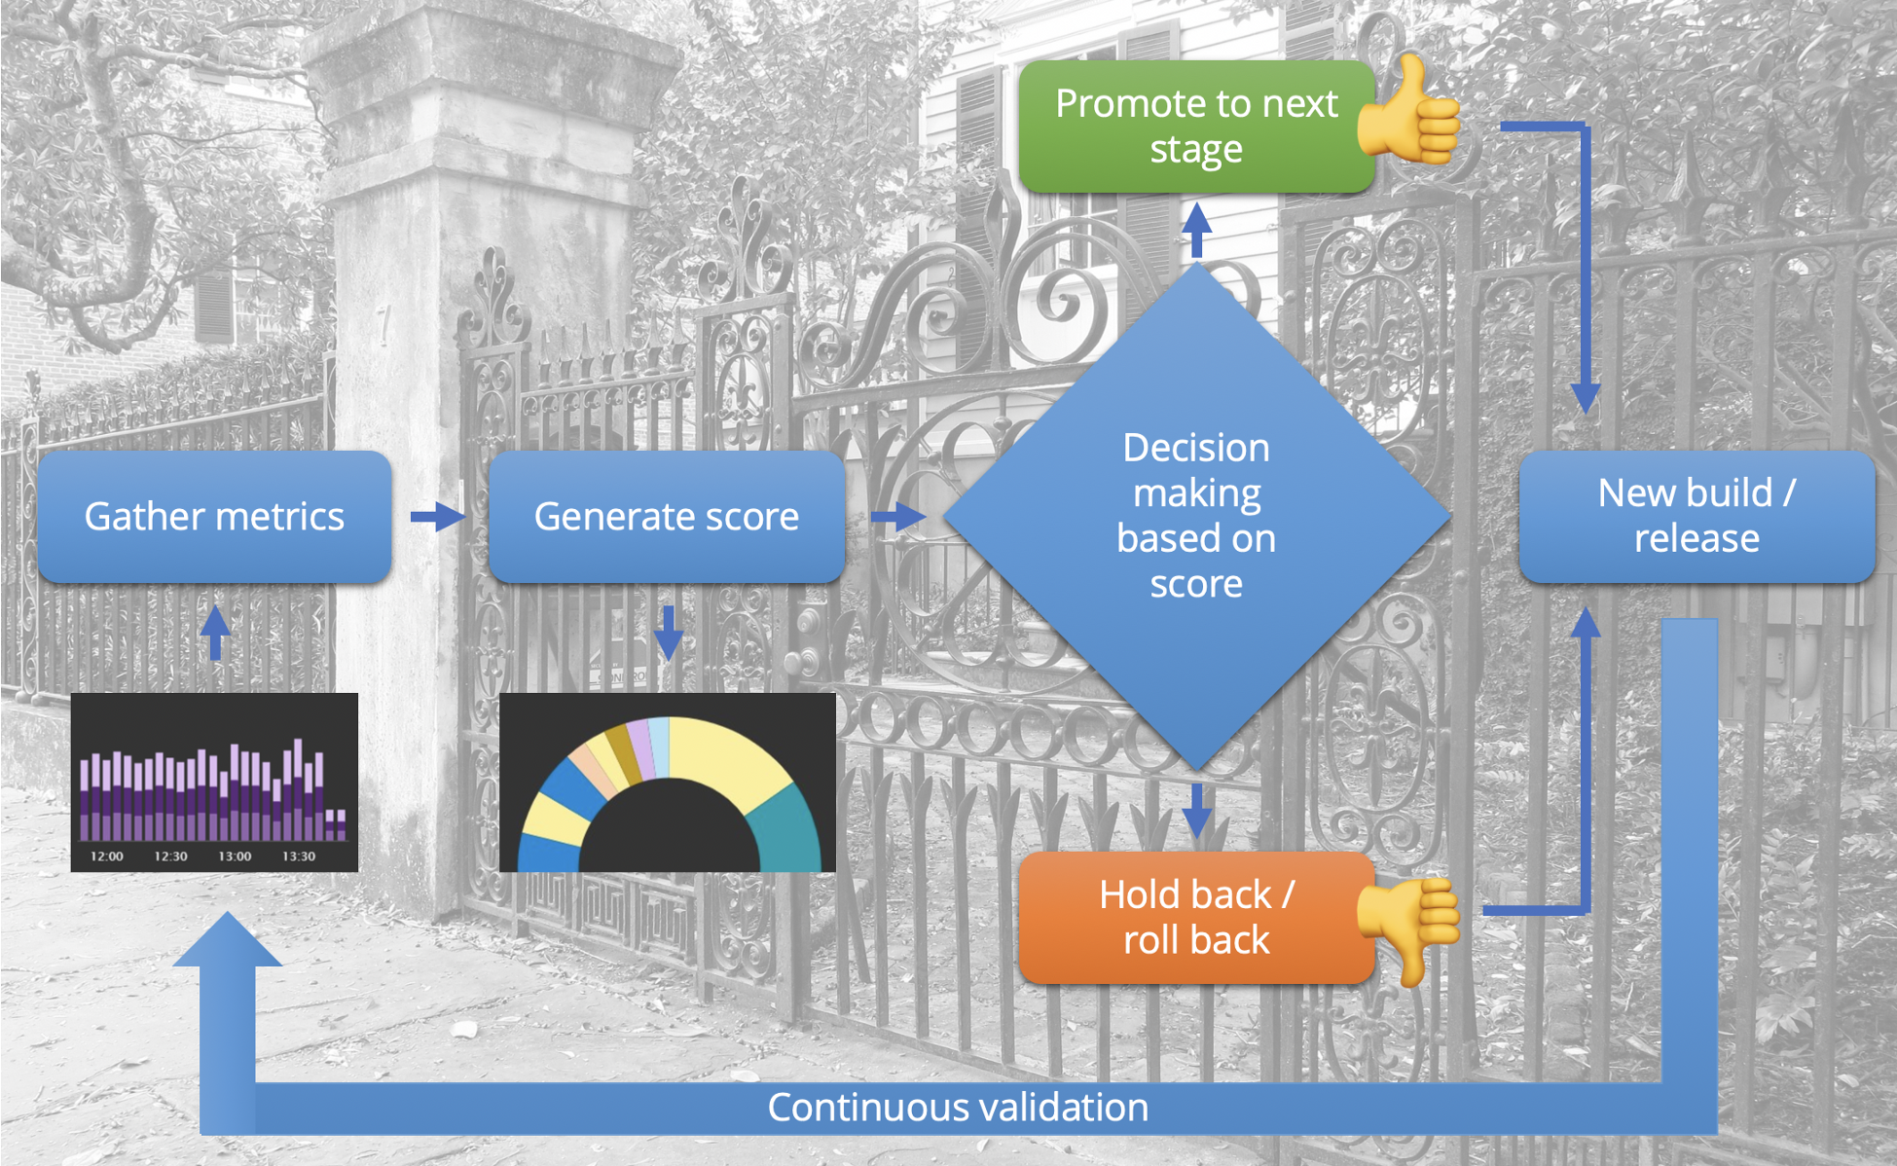
Concept of Quality Gate
background image credit: https://www.flickr.com/photos/hunky_punk/11123714805
Notes:
What we have seen is that the same concepts start “shifting-left” into the continuous delivery pipeline.
To be more concrete: organizations start evaluating every build against their SLOs and let the result act as a Quality Gate before a build is promoted to the next stage of the pipeline and eventually to production.
So we thought about formalizing that process: collect metrics corresponding to the SLIs, calculating a score based on the SLOs and then using that score to make a decision whether the build should move to next stage of the pipeline or not

Slide 9




SLIs, SLOs and scoring with Keptn Quality Gates
SLIs defined per SLI Provider as YAML SLI Provider specific queries, e.g: Dynatrace Metrics Query
1
$ keptn start-evaluation 30m myservice sli.yaml slo.yaml
Quality Gate
indicators:
error_rate: "builtin:service.errors.total.count:merge(0):avg"
count_dbcalls: "calc:service.toptestdbcalls:merge(0):sum"
jvm_memory: "builtin:tech.jvm.memory.pool.committed:merge(0):sum"
Total Score
9/10
(90%)
5/10
(50%)
4
SLOs defined on Keptn Service Level as YAML List of objectives with fixed or relative pass & warn criteria
2
Queries SLI Providers with SLI Definitions & Timeframe
objectives:
- sli: error_rate pass:
- criteria:
- "<=1“ # We expect a max error rate of 1%
- sli: jvm_memory
- sli: count_dbcalls
pass:
- criteria:
- "=+2%" # We allow a 2% increase in DB Calls to previous runs
warning:
- criteria:
- "<=10" # We expect no more than 10 DB Calls per TX
total_score:
pass: "90%"
warning: "75%"
...
Dynatrace
Prometheus
Neoload
Tool X
SLI Value:
5 DB Calls
360MB
4.3%
123
SLI Score:
0.5
1.0
0.0
info
3
Scores SLIs
Notes:
How to find the right SLIs?
The metrics you have on existing dashboards will often be good candidates for SLIs. You will find the way to extract those from your tool using whatever API and query language is available and add those to your SLI.yaml files. You can start with simple SLIs such as Response Time, Failure Rates, CPU Usage or things as such. You may want to also get sophisticated SLIs such as RT when user log in, or nb of DB calls or exception when a user log in.
You also have your SLOs defined in YAML where you can combine static and dynamic thresholds which compare the SLI with value from previous builds.
You can always start with something simple such as a SLO of 10% variation within the SLI value from the previous build.
You have your CI/CD platform sending a command to keptn quality gate service, saying start evaluating that service for 30 minutes using these SLI and SLO definitions
keptn queries the SLI providers for metric values during that 30 minutes
It then calculate a score for each SLI, which are weighted, one SLI can have for example a weight of 2 vs the other one which means it s score will have twice an influence on the total score.
This means a build can still pass the evaluation even if some of its SLIs are below SLOs. In the end total score is pass, failed or it can also be warning, which could mean a human intervention to approve or reject.

Slide 10
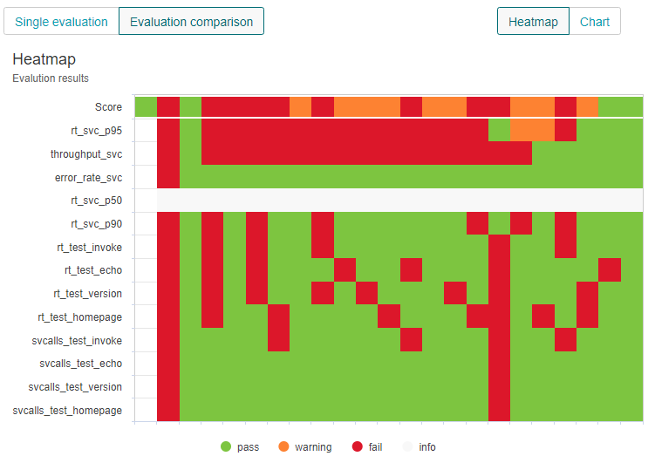
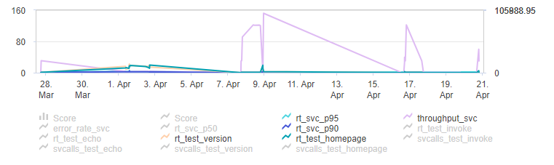
Let keptn automate that analysis for you
Instead of manually comparing timeframes
Keptn automates that process based on SLIs & SLOs
1
2
1
2
3
4
x
3
4
X
1
2
3
4
x
Notes:
Now if you do this, instead of manually analyzing and comparing dashboards from one build to another, the keptn Lighthouse service will do that comparison for you for you.
It look at the metrics and compare them with previous builds or thresholds you defined in your SLO file and calculate an overall confidence score. SLIs vs SLOs. Is it good enough to pass, is it bad enough to fail or is it a bit in between and might need additional assessment.
What we see on the right here is a visualisation from a keptn service called the Bridge.

Slide 11
Quality Gate evaluation results
One Build/Eval
Heatmap
Total Score per Build/Evaluation
SLO Result per SLI
Chart
Values across builds/evaluations
Values per SLI
Notes:
The Bridge offers traceability over events but also a heatmap like this one where you have your SLIs on the y axis and the builds over time on the x axis. And also SLIs charted as what you can see below.
Of course you might want to have this in your own CI/CD tool if you don’t use Keptn to managed your deployments and deliveries and this is all available via API, which is how we implemented integration with GitLabs or Jenkins for example.

Slide 12
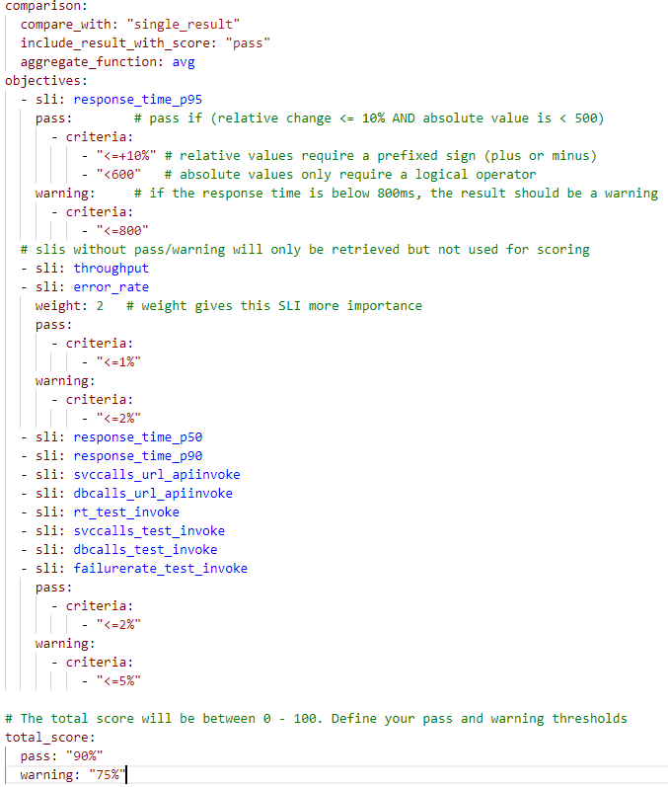
Keptn SLOs explained
SLOs define your criteria for a list of SLIs and are stored in Git
SLOs can be defined per keptn service & stage, e.g: you can have different SLOs for staging and production
Comparison Result
Define to compare with e.g: last passed evaluation result
Objectives: per SLI
Define none or multiple pass and warning criteria
Use absolute or relative values for criteria
Relative compares it with the compared evaluation result
Weight can be defined: Default = 1
Key: if true its a key criteria that can fail the evaluation
Each Objective with a criteria will contributed to a weighted score
„Informational-only“ SLIs
If you dont specify a criteria
Values will be retrieved but not included in scoring
Total Score
Defines the pass, warning and fail ranges for the total score

Slide 13
Example explainer on SLI/SLO-based Evaluation
$ keptn send event start-evaluation myproject myservice starttime=build1_deploy endtime=build1_testsdone
$ keptn send event start-evaluation myproject myservice starttime=build2_deploy endtime=build2_testsdone
$ keptn send event start-evaluation myproject myservice starttime=build3_deploy endtime=build3_testsdone
$ keptn send event start-evaluation myproject myservice starttime=build4_teststart endtime=build4_testsend
SLIs (Service Level Indicators)
SLO
pass
Build 1
Build 1
Build 2
Build 3
Build 4
warn
Build 2
Build 3
Build 4
Response Time 95th Perc
Source: Dynatrace
Query: builtin:service.responsetime(p95)
<=100ms
80ms
120ms
90ms
95ms
<= 250ms
Overall Failure Rate
Source: Dynatrace
Query: builtin:service.errors.total
<= 2%
0%
4%
1%
0%
<= 5%
Response Time LOGIN Tx
Source: Dynatrace
Query: calc:service.responsetime:filter(tx, LOGIN)
<=150ms & <=+10%
100ms
90ms
120ms
95ms
<= 400ms
# DB Calls LOGIN Tx
Source: Dynatrace
Query: calc:service.dbcalls:filter(tx, LOGIN)
<= +0%
3
3
6
3
<= +1
SLO: Overall Score Goal
90%
75%
100%
75%
62.5%
100%

Slide 14
The Setup

Slide 15
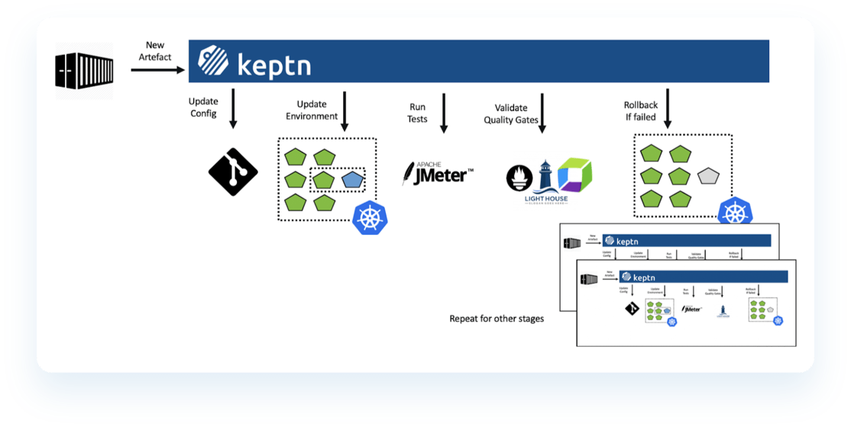
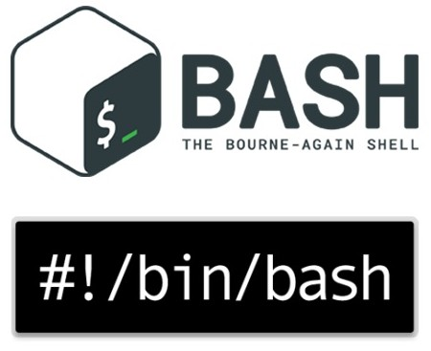



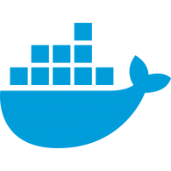









Keptn-in-a-Box - The Setup
Docker
Microk8s
Kubectl
Istio 1.5.1
Helm
Keptn
NGINX Ingress
Certmanager with Let's Encrypt
Sample nodeJS app
Jenkins CasC
Ubuntu 18 LTS
Notes:
It is basically a bash file but in other words it is:
The automation of creating a single node Kubernetes development cluster with Keptn and everything you need to start building and shipping cloud apps through Keptn in a very efficient and effective way.
The bash file is scripted in a modular fashion allowing you with control flags to enable or disable the modules that you want to install in your box. This allows you to have a very slim cluster running keptn with the bare minimal resources or to have a full blown cluster with pretty much all the desired features and frameworks for your CI/CD pipelines and performance testings.
GCP compute instance : n2-standard-4
4 vCPUs, 16GB RAM
Ubuntu 18.04

Slide 16
Hands on

Slide 17
Environment info
In the Slack channel, you will find a spreadsheet with :
Your Dynatrace Managed environment URL
You can use your own SaaS tenant if you want
Your GCP instance nip.io (magic!) domain
The password to access your GCP instance via SSH
Connect to your instance
ssh bootcamp@<your_nip_io>
Password is : keptn-R0ck$
Everything is in the “qg-handson” directory: $ cd qg-handson

Slide 18
IF YOU WANT TO BUILD YOUR OWN ENVIRONMENT
From the GCP Cloud Shell, execute these commands:
$ curl -o gcp_instance.sh https://raw.githubusercontent.com/steve-caron-dynatrace/se-bootcamp-keptn-qg/master/0-Setup/create-gcp-compute-instance.sh
$ chmod +x gcp_instance.sh
$ ./gcp_instance.sh <name_of_your_gcp_project> <name_of_your_instance> <your_name_no_space>
Provide the name of your GCP project, choose a name for your instance, enter your name without space
Once it is created, pull the IP address from the GCP console, you can derive the nip.io domain. For example, IP=35.225.179.91 then domain=35-225-179-91.nip.io
It can take about 5 minutes before you can log in. Password : keptn-R0ck$
$ ssh bootcamp@<your.nip.io>

Slide 19
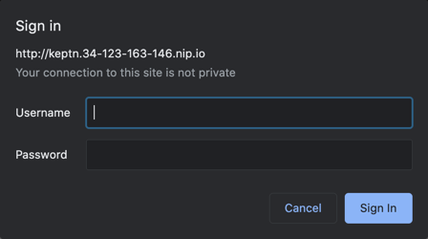
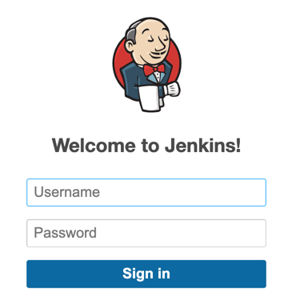
Quick validation
Let’s make sure everything is running:
Sample nodeJS app running in 2 Docker containers (status should be “up”) :
$ docker ps --all
Keptn Bridge :
In your browser : http://keptn.<your_nip_io>
If you get a basic authentication popup, that’s OK
Jenkins Console :
In your browser : https://jenkins.<your_nip_io>
Installation logs :
$ cat /tmp/install.log

Slide 20
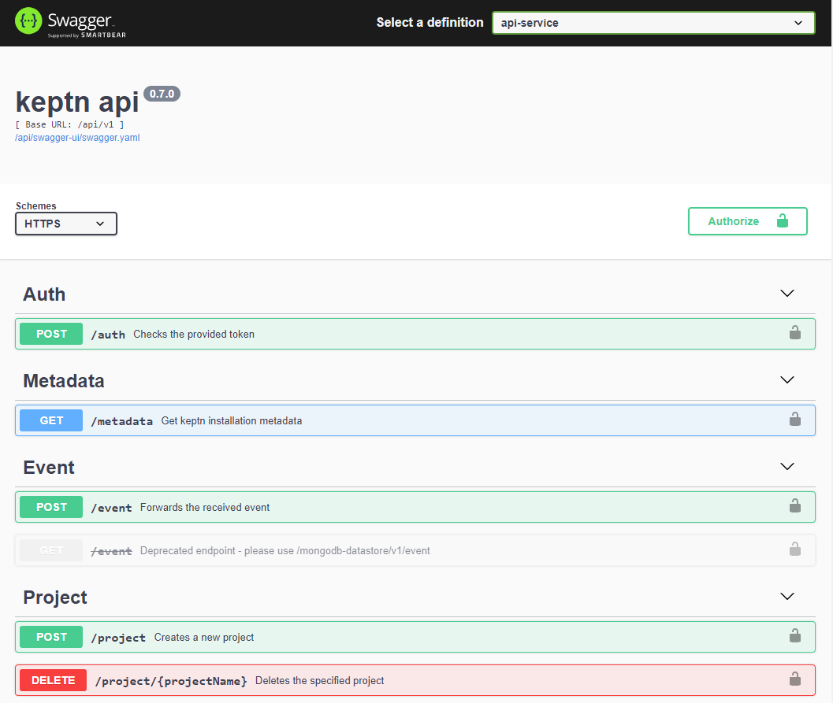
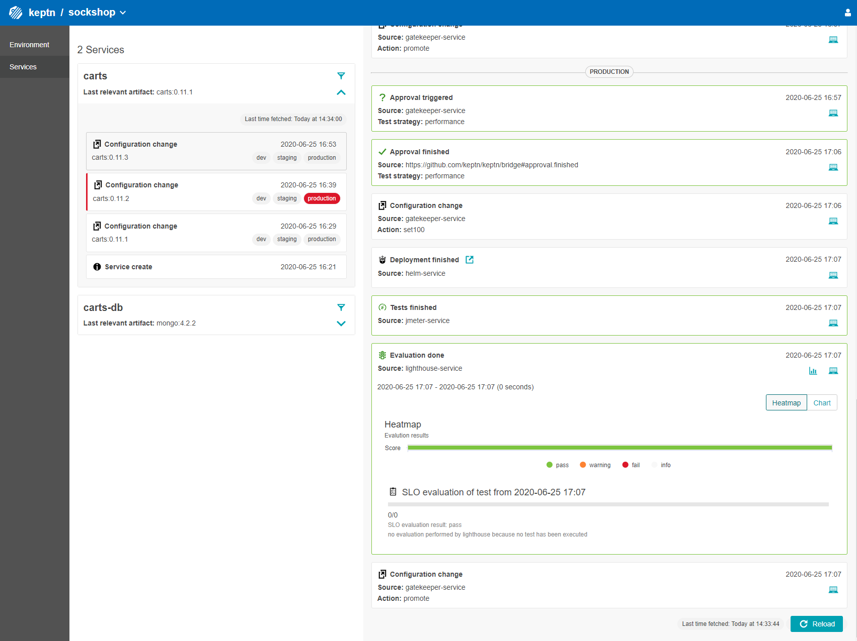
Interfacing with Keptn
There are 3 ways to interface with Keptn
Keptn API
For everything
Used by the integrations
Swaggerized
Keptn CLI
Keptn installation and configuration
Create project & services, send events
Keptn Bridge
Web UI for projects, services and associated events

Slide 21
1 - Keptn Dynatrace Integration

Slide 22
Keptn – Dynatrace integration
For the execution of a Keptn Quality Gate evaluation, we need metrics to compare to the specs
Keptn gets the metrics from a SLI provider
During this session we will use Dynatrace as the SLI provider
Keptn - Dynatrace integration :
Dynatrace providing metrics to Keptn
Keptn pushing events to Dynatrace

Slide 23
OneAgent Installation
Typically, when you deploy the Keptn Dynatrace integration, it will also deploy the OneAgent operator on the Kubernetes cluster Keptn is running on
But, in QG standalone scenarios, the test environment is not managed by Keptn
It might be running on a different Kubernetes cluster than Keptn
It could be running anywhere, doesn’t need to run on Kubernetes
What we’ll first need to do:
Create an API token to be used by the Keptn Dynatrace integration
Deploy the OneAgent on the Linux VM so we can monitor the services and collect data for the Quality Gate evaluation
Restart our Simple Node Service so it gets instrumented
Install the Dynatrace service on Keptn

Slide 24
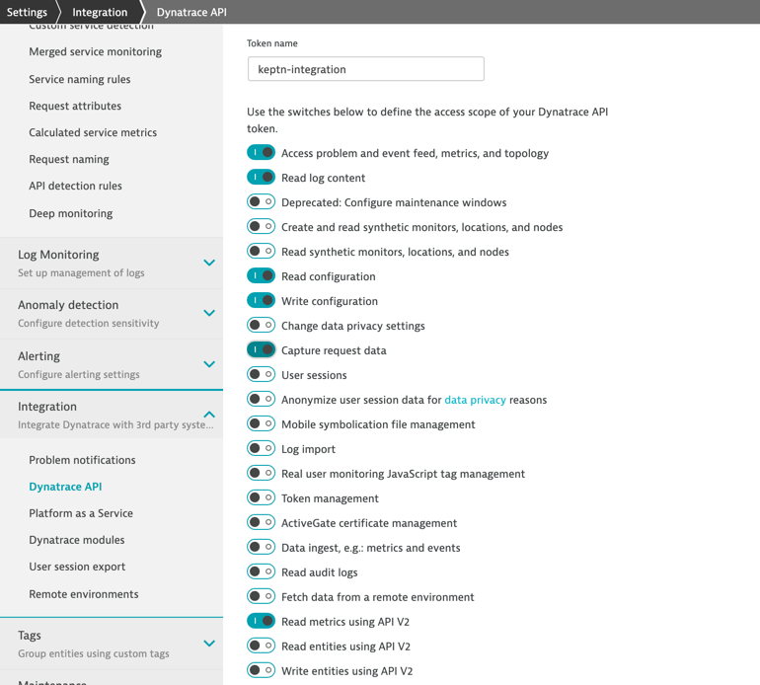
API token for Keptn – Dynatrace integration
Create an API token with the following access scope
Access problem and event feed, metric and topology
Read log content
Read configuration
Write configuration
Capture request data
Read metrics using API V2

Slide 25
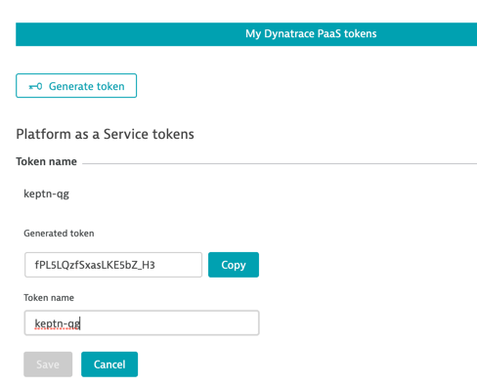
PaaS token for OneAgent
Create a PaaS token for the OneAgent installation

Slide 26
Install OneAgent and set up Keptn Dynatrace integration service
Execute the following script to provide your Dynatrace credentials:
$ cd 1-Dynatrace_Integration/
$ ./get_dynatrace_creds.sh
Enter the tenant name in the following format
SaaS : {your-environment-id}.live.dynatrace.com
Managed: {your-domain}/e/{your-environment-id}
Note : There should be no leading https:// and trailing /
Enter the API and PaaS tokens you created earlier
Once confirmed, the script will store the Dynatrace credentials in : ~/.config/creds.json

Slide 27
Install OneAgent and Keptn Dynatrace integration service
Execute the following script to deploy the OneAgent :
$ ./deploy_oneagent.sh
Note : You might need to provide your Linux password to grant sudo privileges : keptn-R0ck$
The script will also restart the 2 nodeJS sample app containers
Install the keptn dynatrace-service :
$ ./install_dt_keptn_integration.sh
This create a k8s secret to store DT credentials to be used by keptn when needed
This deploy the dynatrace-service on keptn
You can ignore the namespaces “dynatrace” not found errors, those happened because the service tries to deploy the OneAgent Operator
Since our app does not run in Kubernetes, we don’t need to deploy the Operator (you could still do it, but it’s not required)

Slide 28
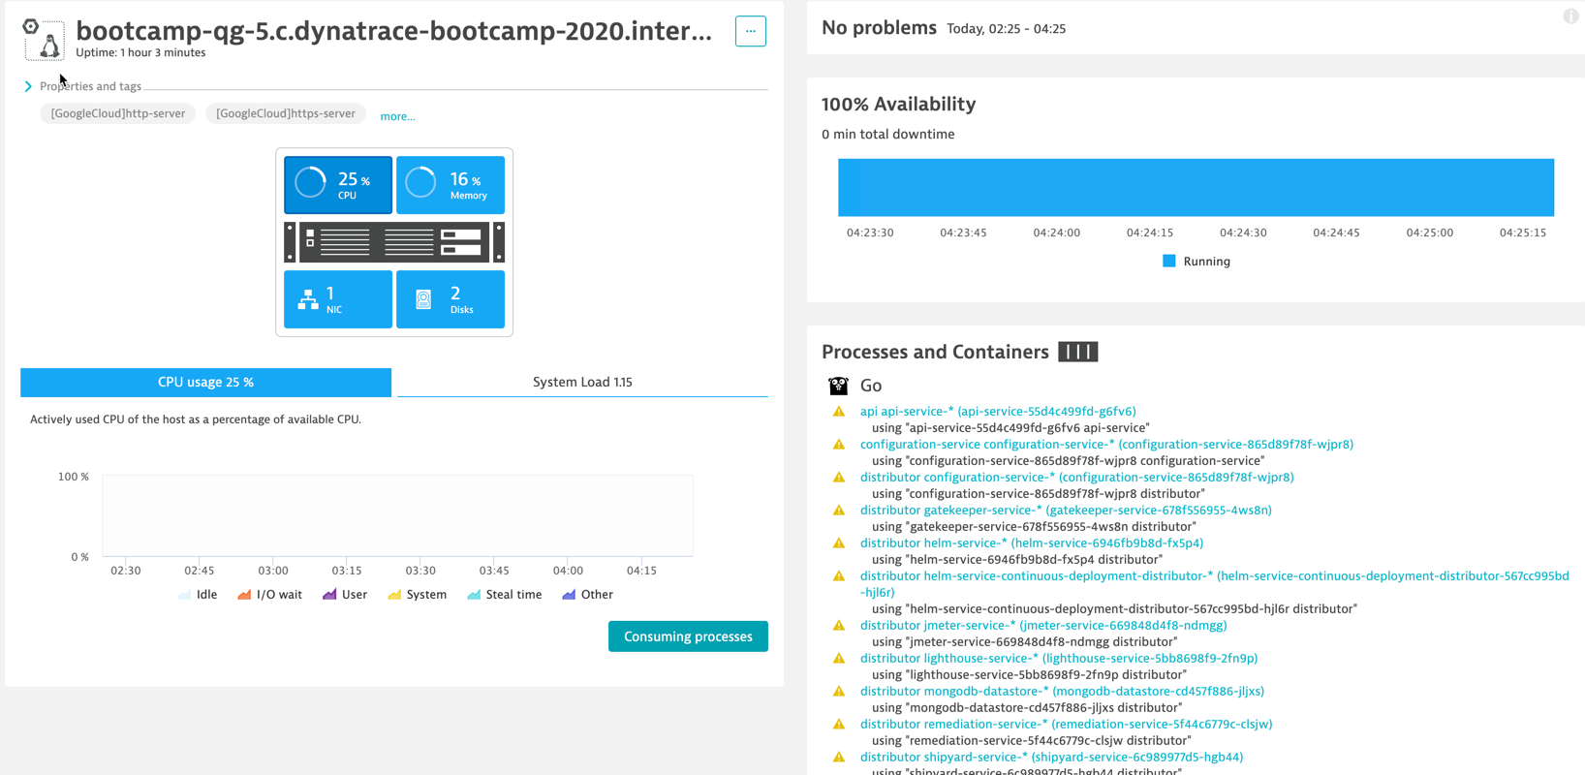
Validation in Dynatrace
Validate the GCP compute instance shows up in Dynatrace

Slide 29
2 - Basic Quality Gate

Slide 30
Keptn Projects and Services
Before setting up a Quality Gate, we need to define a Project and a Service
What is a project?
Structural element to maintain multiple services from a team/application, i.e., one application with multiple (micro)services
A Keptn project is defined by a shipyard file and represents one Git repo
What is a service?
One service of an application (related to a Keptn project)
Configuration is stored in the Git repo
When a service is deployed in multiple stages, its stage-dependent configuration is maintained in a separate branch.

Slide 31
Create Keptn Project and onboard Service
Create the keptn project:
$ cd ../2-Basic_Quality_Gate/
$ keptn create project standalone-qg --shipyard=./shipyard_qualitystageonly.yaml
Once the project is created, services can be added.
In a Progressive Delivery scenario, where keptn is in charge of deploying the service itself in Kubernetes, it needs to be onboarded.
Since our use case is to run the Quality Gate in standalone, the service deployment is independent of Keptn. We just need to add it to project with the create service command:
$ keptn create service simplenodeservice --project=standalone-qg

Slide 32
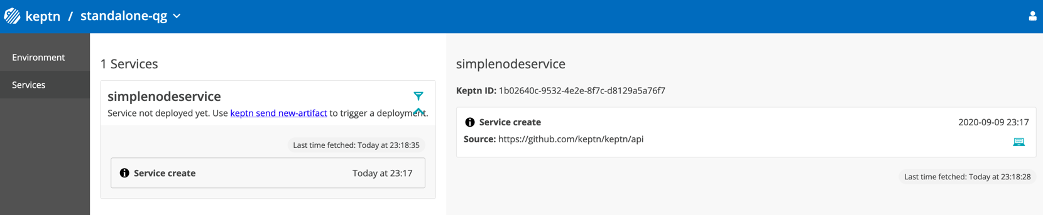
Validation
Use the keptn Bridge to validate the service was added to the project
URL : http://keptn.<your.nip.io>
Get the username (keptn) and password by running this keptn CLI command:
# keptn configure bridge --output
Select the standalone-qg project
Click on the simplenodeservice
The service events are listed. For now, there’s only the create event

Slide 33
Set up SLI provider
Evaluation of the Quality Gate requires a SLI provider
Keptn service that will fetch the SLI values that are referenced in the SLO definition.
Different SLI providers exist, in this session, we use the Dynatrace SLI provider service
Deploy the service:
$ kubectl apply -f https://raw.githubusercontent.com/keptn-contrib/dynatrace-sli-service/0.5.0/deploy/service.yaml
The service requires tenant ID and API token to retrieve the metrics from Dynatrace
Those values from the secret (named dynatrace) we already have created
Configure the project with the new SLI provider
$ keptn configure monitoring dynatrace --project=standalone-qg

Slide 34

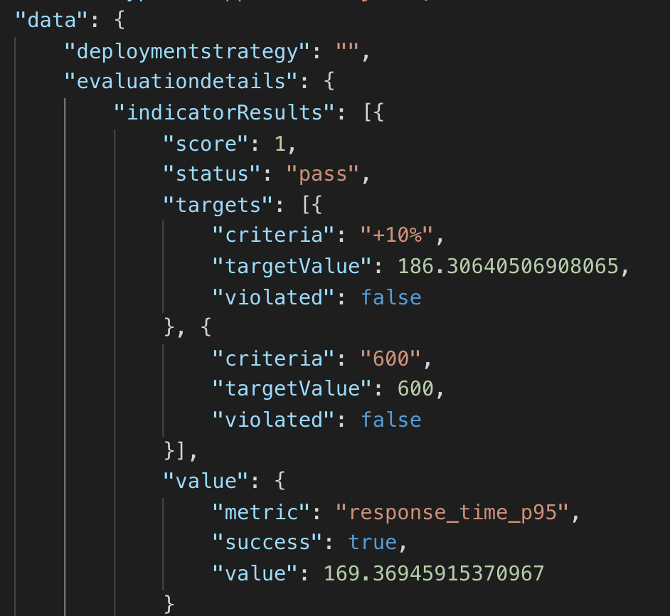
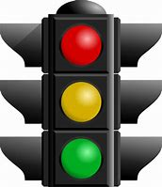


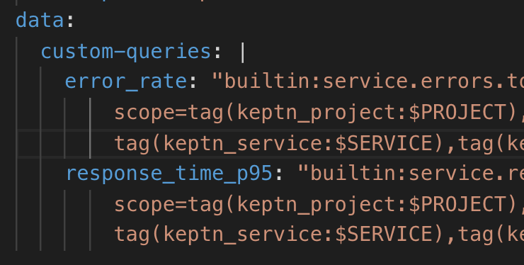
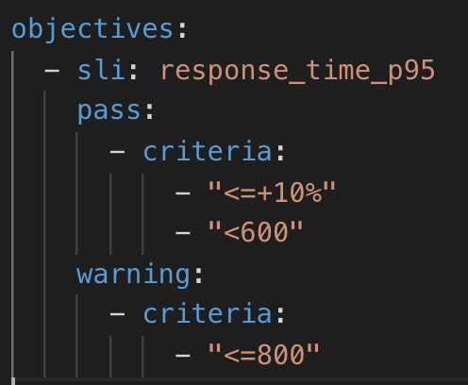
Keptn Quality Gate Service
Your Delivery Tool
#1 Call Service
Result
#2 SLO File
#3 SLI File
...
Tool X

Slide 35
Set up Quality Gate – SLIs and SLOs
Keptn Quality Gates are based on these 2 concepts:
Service Level Indicators (SLIs) : what are the metrics (indicators) and how are their value fetched
Service Level Objectives (SLOs) : what are the conditions (objectives) that must be met to consider an indicator value good or bad
In this exercise, we will use basic sets of SLOs and SLIs.
Keptn SLIs and SLOs are defined in yaml files. Let’s take a look at those definitions.
Add the basic SLI definition to keptn
# keptn add-resource --project=standalone-qg --stage=qualitystage --service=simplenodeservice --resource=dynatrace/sli_basic.yaml --resourceUri=dynatrace/sli.yaml
Add the basic SLO definition to keptn
# keptn add-resource --project=standalone-qg --stage=qualitystage --service=simplenodeservice --resource=slo_basic.yaml --resourceUri=slo.yaml

Slide 36
Set up Quality Gate – Dynatrace Event Feed
We have seen that Dynatrace integrates with Keptn as a SLI provider
The integration also allows Keptn to push events associated to the Quality Gate evaluations to the associated Dynatrace entities (via the Events API)
How does Keptn knows to which entities the events should be associated to?
This is defined in a dynatrace.conf.yaml file
The file contains a set of tagging rules. The events will be associated to the entities with the corresponding tags
Add the file as a resource to the project, service and stage
# keptn add-resource --project=standalone-qg --stage=qualitystage --service=simplenodeservice --resource=dynatrace/dynatrace.conf.yaml --resourceUri=dynatrace/dynatrace.conf.yaml

Slide 37
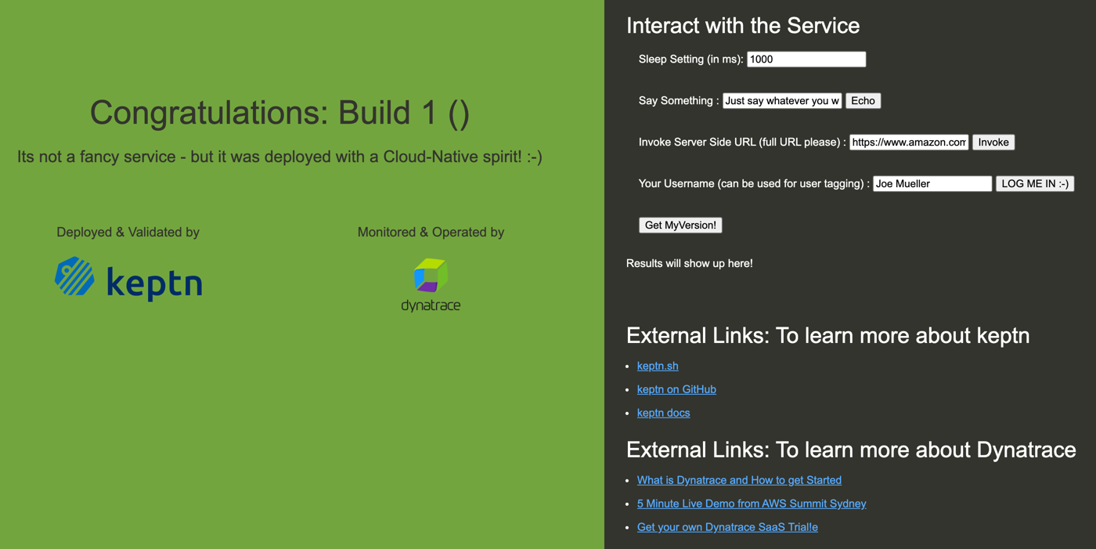
Simple node service app

Slide 38
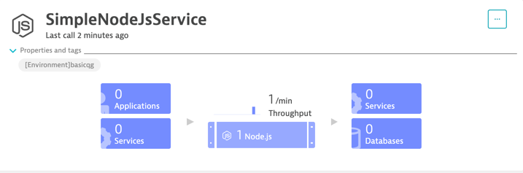
Simple node service app
This is a basic nodeJS app running in a standalone Docker container (not in Kubernetes)
URL: http://<your.nip.io>:8070
You can set Sleep time that will influence the response time
Hit any button to generate traffic
Validate that it shows up as a Service in Dynatrace

Slide 39
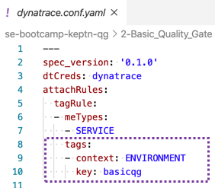
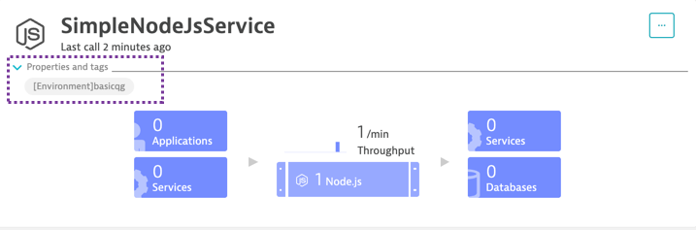
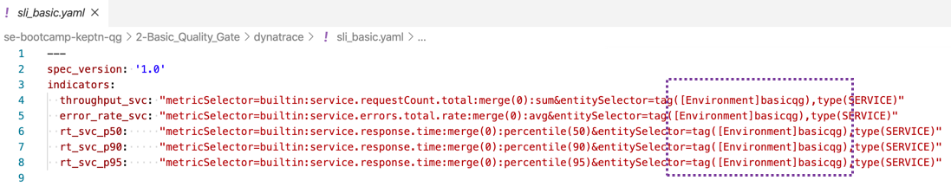
Notice the tag

Slide 40
Quality Gate Evaluation
So now that all is set up, it’s time to run a Quality Gate evaluation!
First, we need data for the SLIs – we need to run a test
This will be a manual test on the simple node service web page
Change the Sleep settings to 500ms
Hit the Echo button about 10 times
Send the evaluation start event to Keptn; this will request an evaluation on the last 2 minutes (timeframe)
# keptn send event start-evaluation --project=standalone-qg --stage=qualitystage --service=simplenodeservice --timeframe=2m --labels=type=viacli

Slide 41
Quality Gate Evaluation
The start-evaluation event returns a Keptn Context ID
As the evaluation is an asynchronous process it may take a while until the results are available.
The Keptn Context can be used to query the status of our request
Check if the Quality Gate evaluation is completed and results are available
$ keptn get event evaluation-done --keptn-context=<Context_ID>
Replace <Context_ID> with the value returned from the previous command (send start-evalution)
Re-execute the same command a few times until it returns an event with results. It might take a minute or two.
The evaluation-done event returns results in JSON format

Slide 42
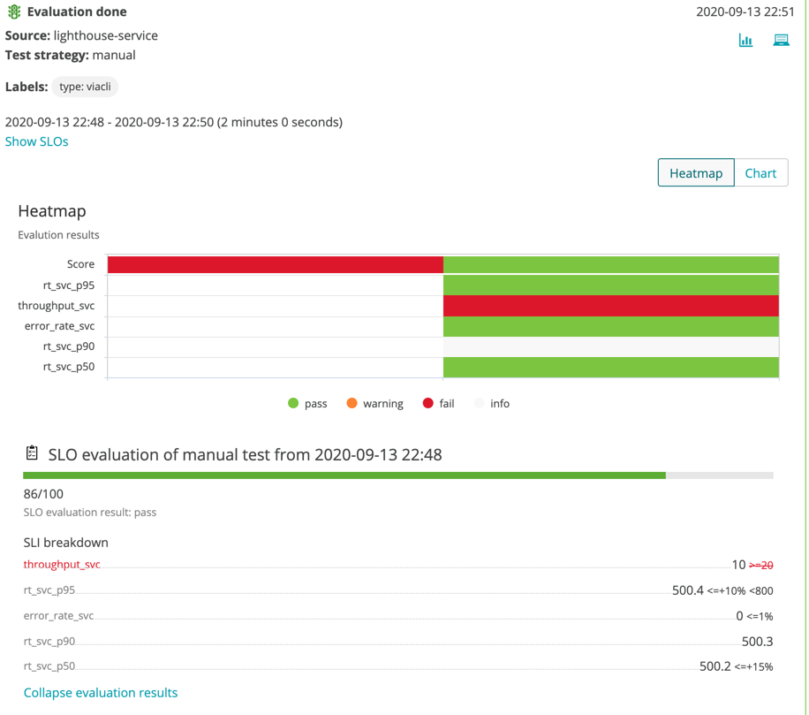
Quality Gate Evaluation
Take a look at the Bridge
A new Start Evaluation event will be listed under the Service
For this event, you have the evaluation results as heat map, chart and SLI breakdown

Slide 43
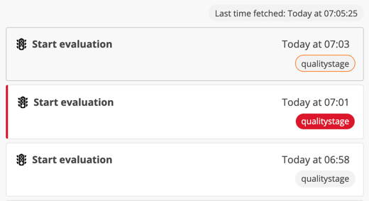
Quality Gate Evaluation
Let’s run some more evaluations
# ./run_basic_test.sh http://<your.nip.io>:8070
This script launch 3 gate runs of http requests to the nodeJS app via curl
It also send a start-evaluation event for each run
The script will take about 6 minutes to complete
Keep an eye on the Bridge
3 evaluation events will show up
The screen is refreshed every minute
Each evaluation has a different status

Slide 44
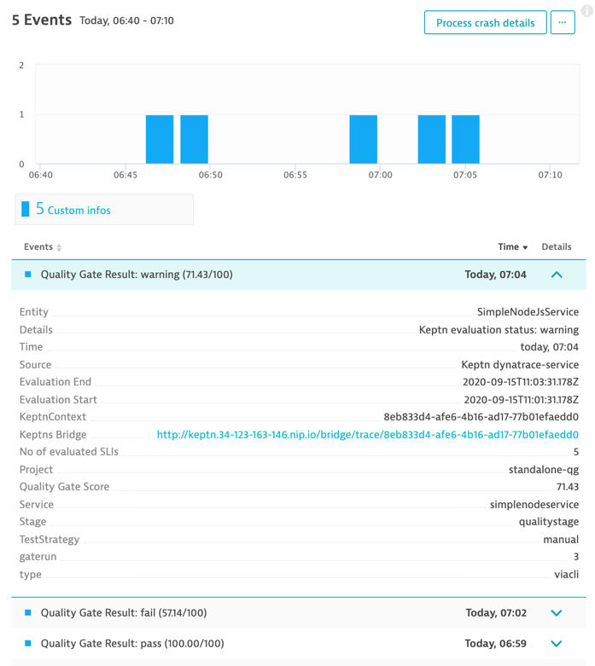
Quality Gate Evaluation
Switch to Dynatrace, look at the nodeJS service
Keptn push the Quality Gates evaluation as Custom Info events

Slide 45
Keptn Quality Gates with Jenkins

Slide 46
Configure Dynatrace
In the previous exercises, our test was very basic – a single http request executed multiple times
In the real world, tests are more complex – multi-steps
We need to have different SLOs for each test step
We have seen during the last run how a different http request can skew the Service Response Time SLI metric.
So this means we also need to have different SLI metrics for each test step
We will leverage Calculated Service Metrics in order to get distinct metrics for each test step
We will also use Request Attributes to capture the http header identifying the test step

Slide 47
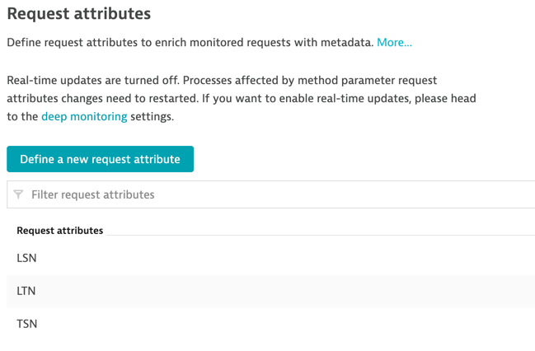
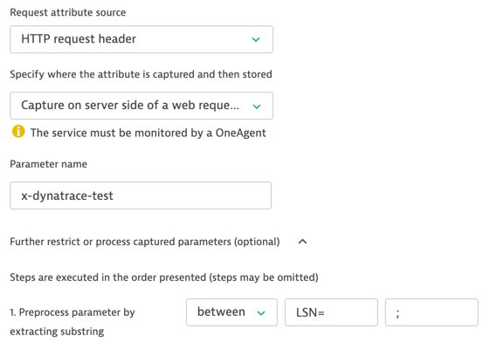
Configure Dynatrace – Request Attributes
Execute the following script to create Request Attributes rules via the Dynatrace Configuration API
# ./createTestRequestAttributes.sh
This creates 3 Request Attributes named: LSN, LTN and TSN

Slide 48
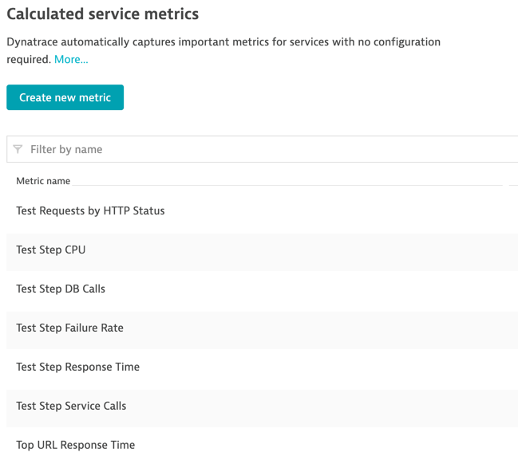
Configure Dynatrace – Calculated Service Metrics
Execute the following script to create Calculated Service Metrics via the Dynatrace Configuration API
# ./createTestStepCalculatedMetrics.sh ENVIRONMENT jenkinsqg
The calculated service metrics will be associated to services specifically tagged
We pass these arguments to the script : tag context (ENVIRONMENT), tag key (jenkinsqg)

Slide 49
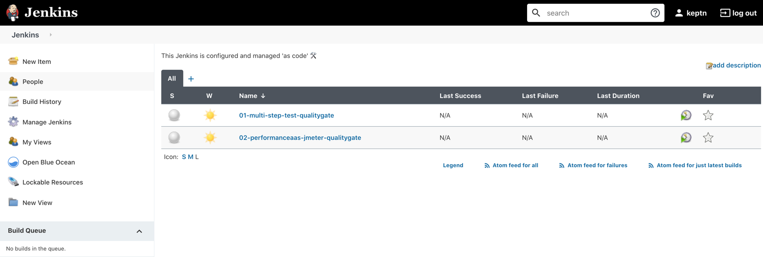
Jenkins
Log in the Jenkins console
URL : https://jenkins.<your.nip.io>
username: keptn
password: keptn

Slide 50
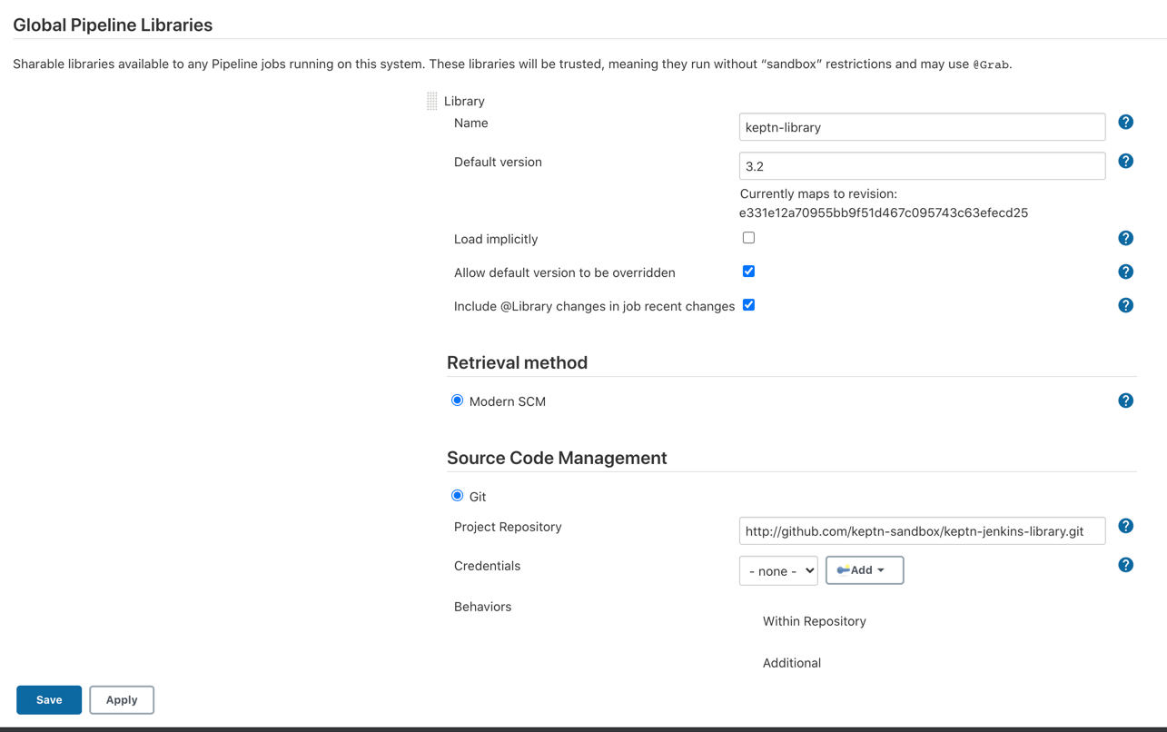
Keptn Jenkins Library
The integration between Jenkins and Keptn is done via a library
The Keptn Jenkins Library is still in sandbox (the graduated integrations are in contrib)
Wraps keptn API calls in groovy methods
Required plugins:
httpRequest Plugin
Pipeline Utility Step Plugin

Slide 51
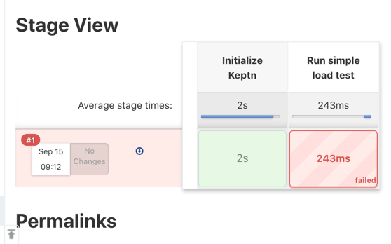
Multi-step Quality Gate pipeline
The pipeline is configured as code (from SCM – github repo)
The Jenkins file is located in the 3-Jenkins_Integration directory
Launch the build : Pipeline 01-multi-step-test-qualitygate -> Build now
It will fail the first run – this is normal because there’s no parameter set. Refresh the page.

Slide 52
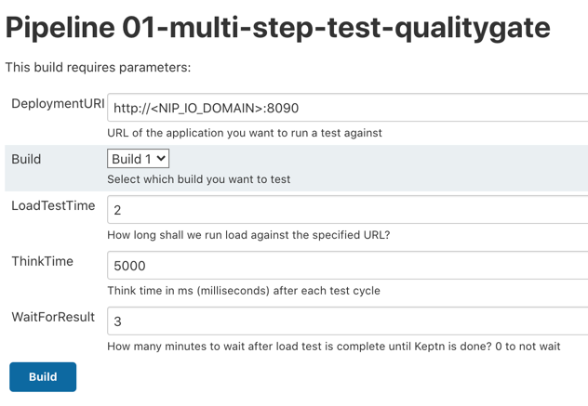
Multi-step Quality Gate pipeline – Build 1
Now there should be a Build with Parameters button
Launch again
For the DeploymentURI parameter, replace with your.nip.io domain.
Pick Build 1.

Slide 53
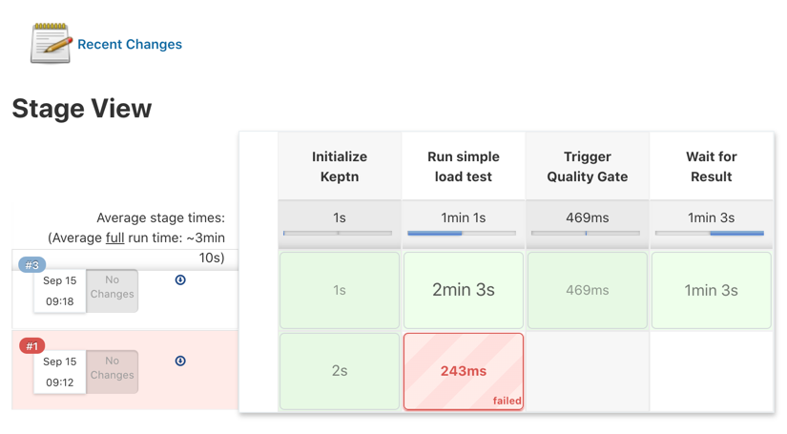
Multi-step Quality Gate pipeline – Build 1
Build 1 passed
Let’s look at it in the Bridge
...and Dynatrace!

Slide 54
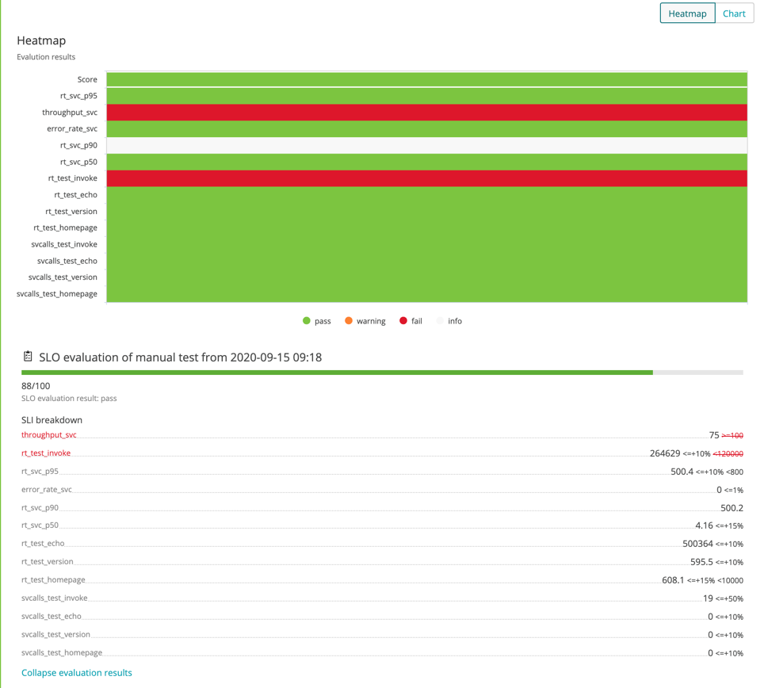
Multi-step Quality Gate pipeline – Build 1
Build 1 passed
Let’s look at it in the Bridge
...and Dynatrace!

Slide 55
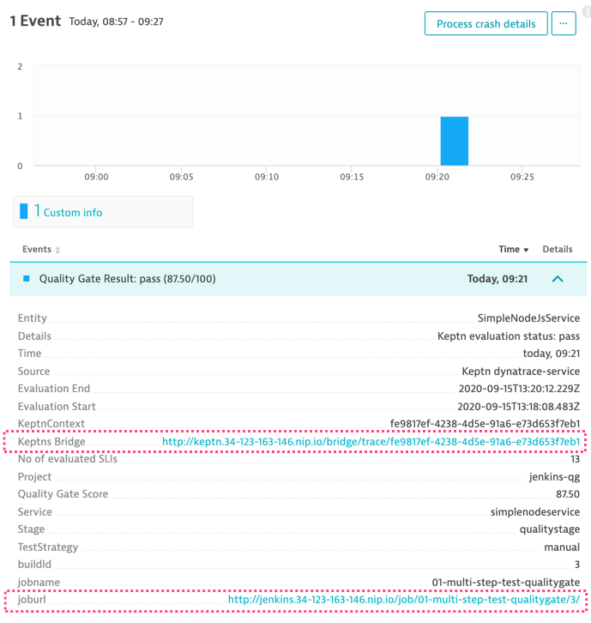
Multi-step Quality Gate pipeline – Build 1
Build 1 passed
Let’s look at it in the Bridge
...and Dynatrace!

Slide 56
Multi-step Quality Gate pipeline – Build 1
Build 1 passed
Let’s look at it in the Bridge
...and Dynatrace!

Slide 57
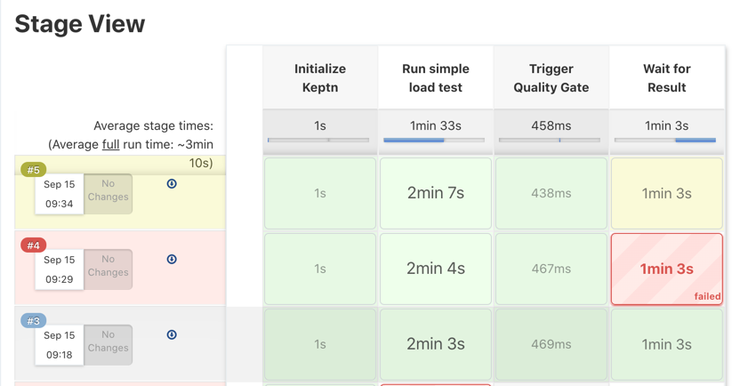
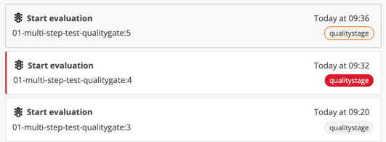
Multi-step Quality Gate pipeline – Builds 2 and 3
Repeat for Builds #2 and #3
Build #2 fails
Build #3 is in warning
Let’s find out why

Slide 58








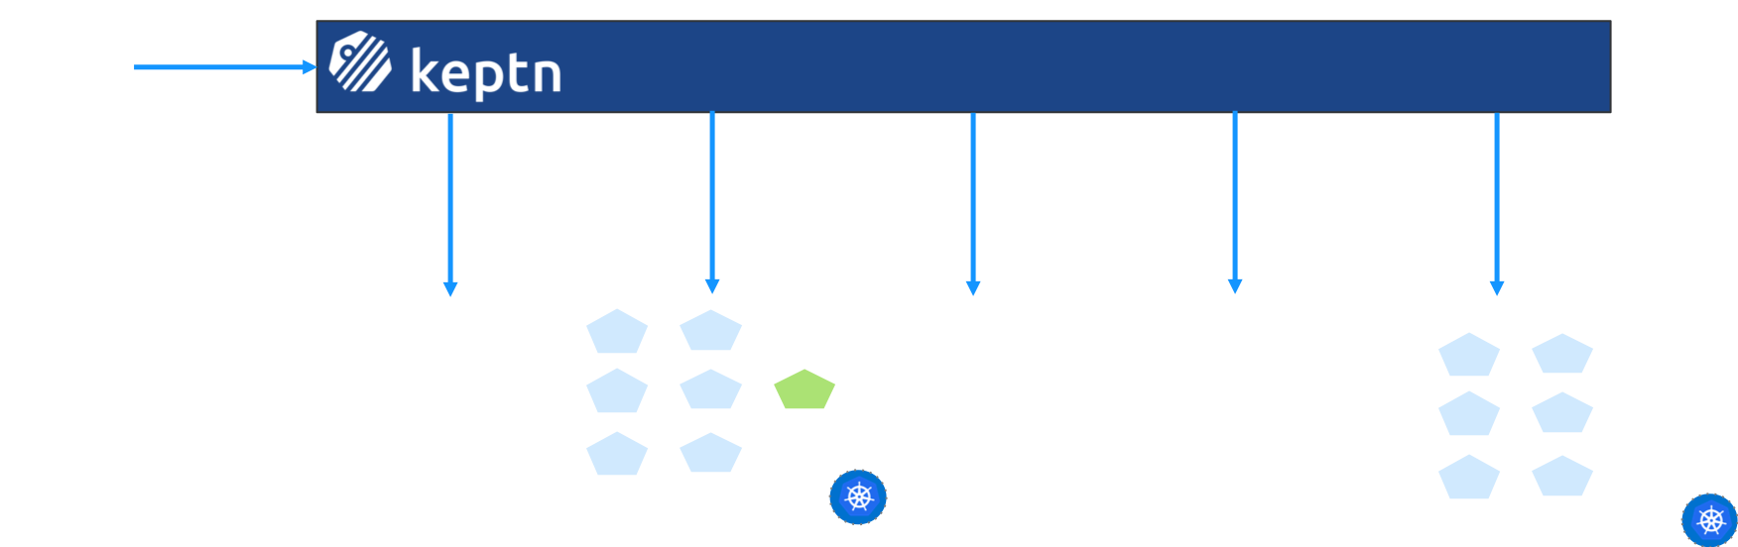
Continuous Delivery
New artifact
Update
Config
Deployment of Artifact
Run
Tests
Validate Quality Gates: SLO
Release or
Rollback
Repeatable for other stages:

Slide 59

Automated Operations
Alert by Problem
Get remediation action
Execute
remediation
action
Re-validate SLO
Escalate?
v1
v1
v2
v1
Examples:
Rollback to old version
Toggle feature flag
Scale up Deployment/restart Pods
YOUR manual operation tasks

